Slide 1
For such a time as this
Esther 4:14
12 Mar 2017
Grace Liew
Notes:
We are living in a critical time like never before. All around us, have you noticed just a "craziness" to everything? Politics, media, Hollywood, everything has become political, everything has become a weapon for minority groups to further their agendas/propaganda. It is an unprecedented time where the enemy is boldly launching attacks on the identity of men and women (as expressly created in the image of God), the christian faith, on Israel etc.
Yesterday, I ran a Parables catch up class with a handful of people. And we studied three of the Kingdom Parables in Matthew. These parables were all in relation to the last days/end time. And it has extraordinary application to believers like us living in these last days/end time. I would like to take some time to highlight the key takeaways from these three parables in relation to our daily lives here today.

Slide 2
Introduction
Matt 24 speaks about the second coming of Christ
V42 “Watch therefore, for you do not know what hour your Lord is coming.”
Matt 25 starts off with Then the Kingdom of Heaven is likened to…
  Parable of the Wise and Foolish Virgins (v1-13)
  Parable of the Faithful and Slothful Servant (v14-30)
Parable of the Marriage of the King’s Son (Matt 22:2-14)

Slide 3
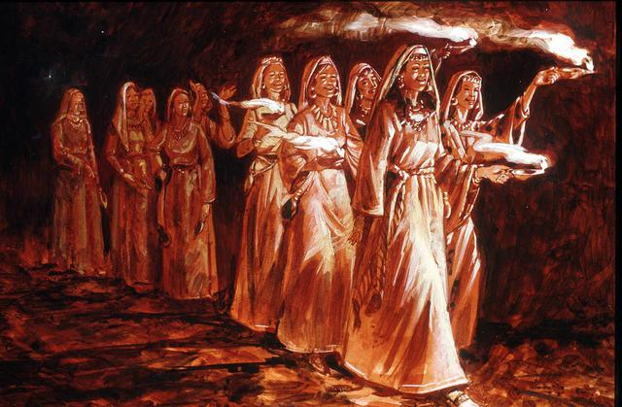
Parable of the
Wise and Foolish Virgins
Matt 25:1-13
Notes:
Five wise virgins had lamp (vessel) and additional supply of oil in a (separate) vessel
Five foolish virgins just had their lamp (vessel) and enough oil in their lamp
All virgins slept and slumbered while the bridegroom was delayed
At midnight, the cry went out. The foolish virgins realised that they didn’t have enough oil because their lamps were going out. So, they asked that the wise share their oil with them.

Slide 4
What does it mean?
The Lamp represents man’s spirit (Prov 20:27)
The Oil in the Lamp represents the Holy Spirit
Virgins all fell asleep. this sleep is a spiritual drowsiness and lethargy (Luke 9:32, Matt 26:4, Rom 13:11-12)
  “And do this, knowing the time, that now it is high time to awake out of sleep; for now our salvation is nearer than when we first believed. ¹² The night is far spent, the day is at hand. Therefore let us cast off the works of darkness, and let us put on the armor of light.”
Midnight is the darkest hour of the night. It represents the end of the age. The call has gone out for all to enter the wedding banquet hall

Slide 5
Key takeaways
We cannot live off another’s spiritual experience (the foolish tried to gain from the wise what could not be bought)
We must personally carry for ourselves an extra supply of the Holy Spirit!
  God wants us to experience personal breakthrough
  Hook onto the prayer movement happening right now!
Maintain an attitude of Watching and Praying
  Watch so that you can pray with purpose!
  Watch so that you can be that agent of change

Slide 6
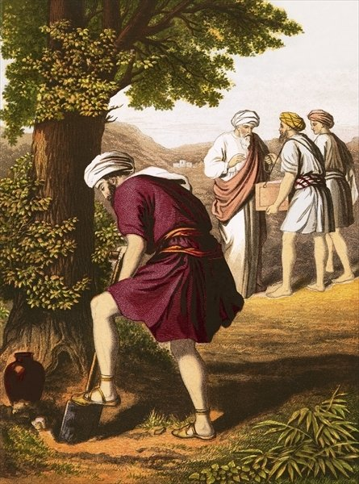
Parable of the
Used and Unused Talents
Matt 25:14-30
Notes:
Five wise virgins had lamp (vessel) and additional supply of oil in a (separate) vessel
Five foolish virgins just had their lamp (vessel) and enough oil in their lamp
All virgins slept and slumbered while the bridegroom was delayed
At midnight, the cry went out. The foolish virgins realised that they didn’t have enough oil because their lamps were going out. So, they asked that the wise share their oil with them.

Slide 7
What does it mean?
The man travelling to the far country is Jesus’ ascension into Heaven.
v14 He delivered his goods to them
v15 To each according to his own ability
God has given us natural and spiritual talents:
  Natural talents: vocational skills, mental capacity, leadership gifts, ability to work with people etc
  Spiritual talents: 9 gifts of the Holy Spirit (1 Cor 12), 5-fold ministries (Eph 4:11), Other functions/ministries (Rom 12:1-8)

Slide 8
The expectation of the Giver
The expectation of the man who gave his goods (his talents) was that each servant
  Used and
  Reproduced
  that which was given.
God has given us talents. He has not given us more than we can handle
He does expect us to use it and reproduce.
This requires faithfulness and focus
Notes:
The local church is the place where you discover your gifts, callings and talents.
But this requires faithfulness and focus.
Sometimes we don’t want to do what God has called us to do. We want to do something else. We want what other people have. We want to be up the front leading. We want to do the big things but are not willing to do the little thankless things. There are a lot of jobs that are very thankless, unseen, nobody wants because you hardly get any recognition for it. this is like what was preached about a month ago. Don’t despise your small beginnings. Stay faithful.
V 29 “For to everyone who has, more will be given but from him who does not have, even what he has will be taken away.“
this was the case for the man with only one talent. He didn’t do anything with it. Maybe he was upset that he was only given one talent so he decided it wasn’t worth putting any effort since it was only one talent after all. Why was his talent given to the one who now had ten? Why overload the guy with ten talents? Because God knew that he could handle it. He doubled what he was given.
The other important thing to note here is that you can grow your ability. God gives us according to the ability of each person. The person who started out with five talents increased to ten and an additional talent was given to him. You may start out with few talents but because of your faithfulness, grow your ability to handle more. God gives the increase.
John 15

Slide 9
Why is this applicable to us today?
Parable | Key Takeaway
Wise and Foolish Virgins | Maintain an attitude of watchfulness and prayer
Used and Unused Talents | Discover the talents that God has given to us. Use and reproduce it or lose it!
The enemy’s plan is to distract us, bog us down
with bitterness/problems and make us feel
discouraged so that we cannot realise our full potential!

Slide 10
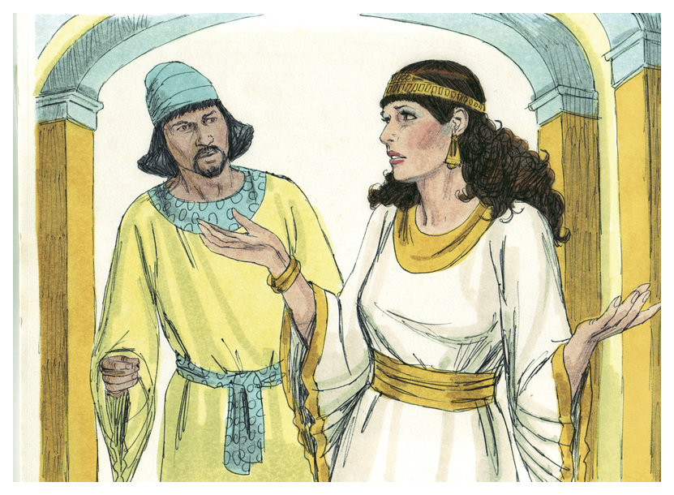
For such a time as this
If you remain completely
silent at this time…but
you and your father’s
house will perish. Yet who knows whether you have
come to the Kingdom for
such a time as this.
Notes:
If you remain completely silent at this time….but you and your father's house will perish. Yet who knows whether you have come to the kingdom for such a time as this. I would like to invite you to rise to the challenge during this hour to awaken out of spiritual sleep and slumber to be sober, vigilant and watchful.
Easter Parade – visible demonstration. Take back Easter as a Christian celebration.

